Slide 1
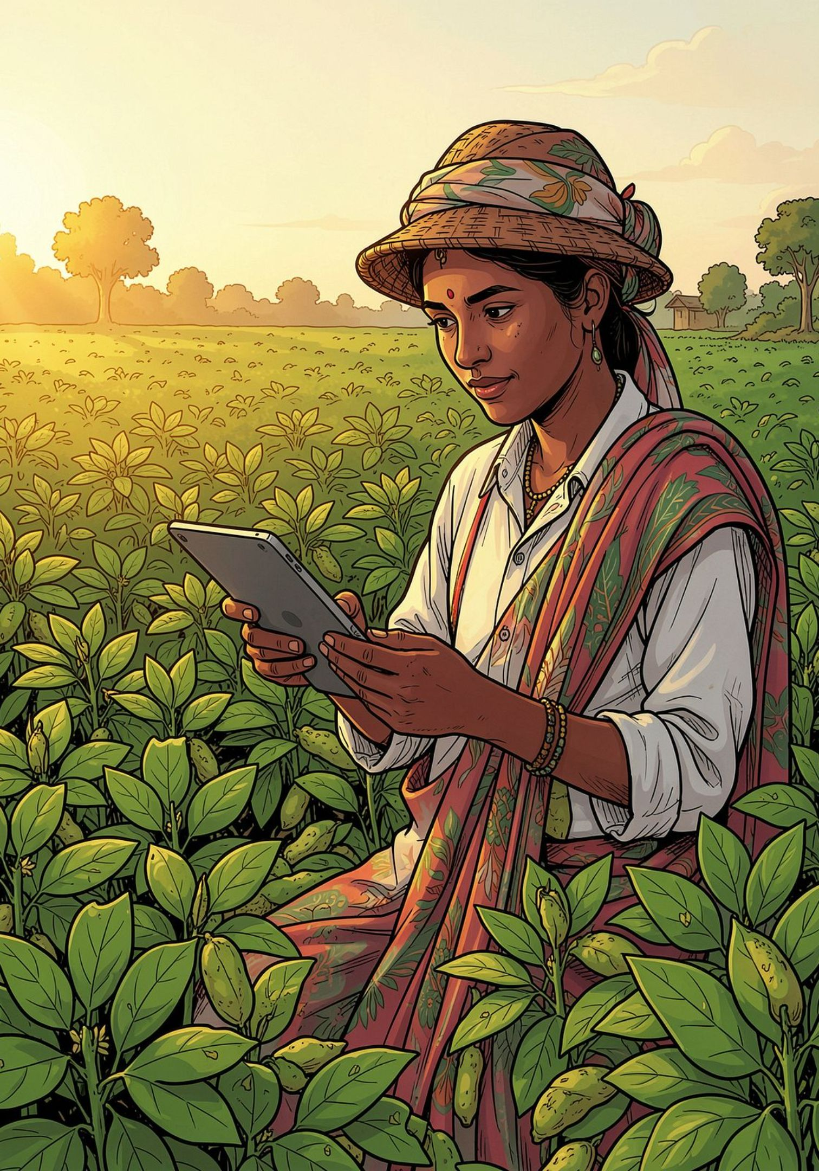
AgriBridge — AI-Powered Climate‑Resilient Agricultural Intelligence
Local advice. Shared knowledge. Sustainable harvests.
Team
Track
TECH VISION — researchers, agronomists, ML engineers
AgriN / Regenerative Agriculture — smallholder focus
Core Tech
AI • Satellite Intelligence • IoT • Computer Vision • Generative AI
Tech Vision

Slide 2
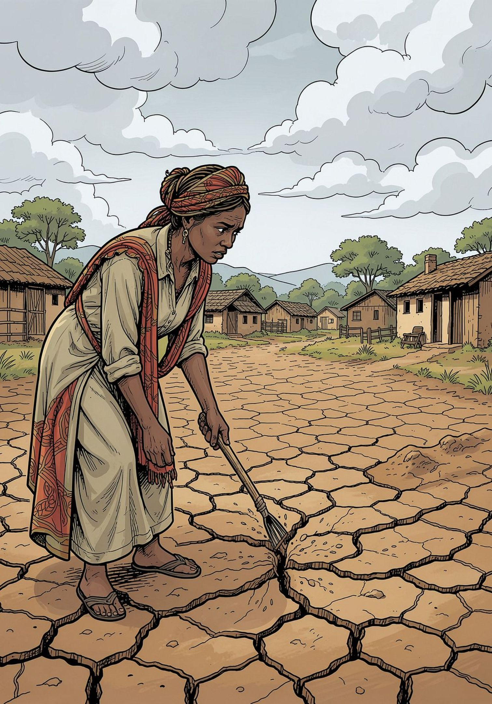

The Problem Farmers Face
Increasingly unpredictable weather undermines planning and yields.
Farmers lack timely, farm‑specific, actionable recommendations.
Crop diseases are often identified too late for effective response.
Soil, satellite and local observations are fragmented and siloed.
Digital tools are hard to access for rural, low‑bandwidth users.
Language and connectivity barriers limit adoption of agtech.
One-line problem: Farmers don't lack data — they lack one simple system that converts scattered agricultural data into actionable decisions.

Slide 3
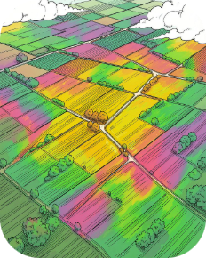
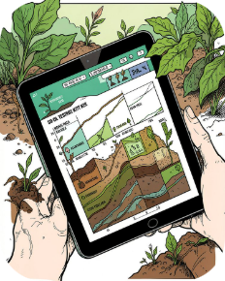
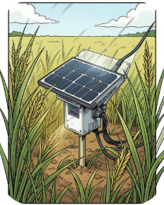
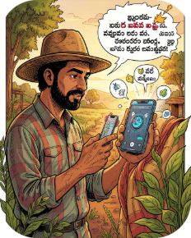
Introducing AgriBridge
AgriBridge unifies diverse data sources into a farmer‑friendly decision support platform tailored for smallholders. It turns data into practical, localised actions.
Satellite & Vegetation
Soil Intelligence
IoT Telemetry
Generative AgriAI
Near real‑time NDVI and true‑color maps for field‑level monitoring.
SoilGrids integration for nutrient and moisture context at plot scale.
Low-power sensors (ESP32 + MQTT) stream soil and canopy telemetry.
Context‑aware, vernacular assistant for practical guidance and planning.
Initially piloted around groundnut farming in Kurnool and designed as a digital public good for smallholder and marginal farmers.
Tech Vision

Slide 4
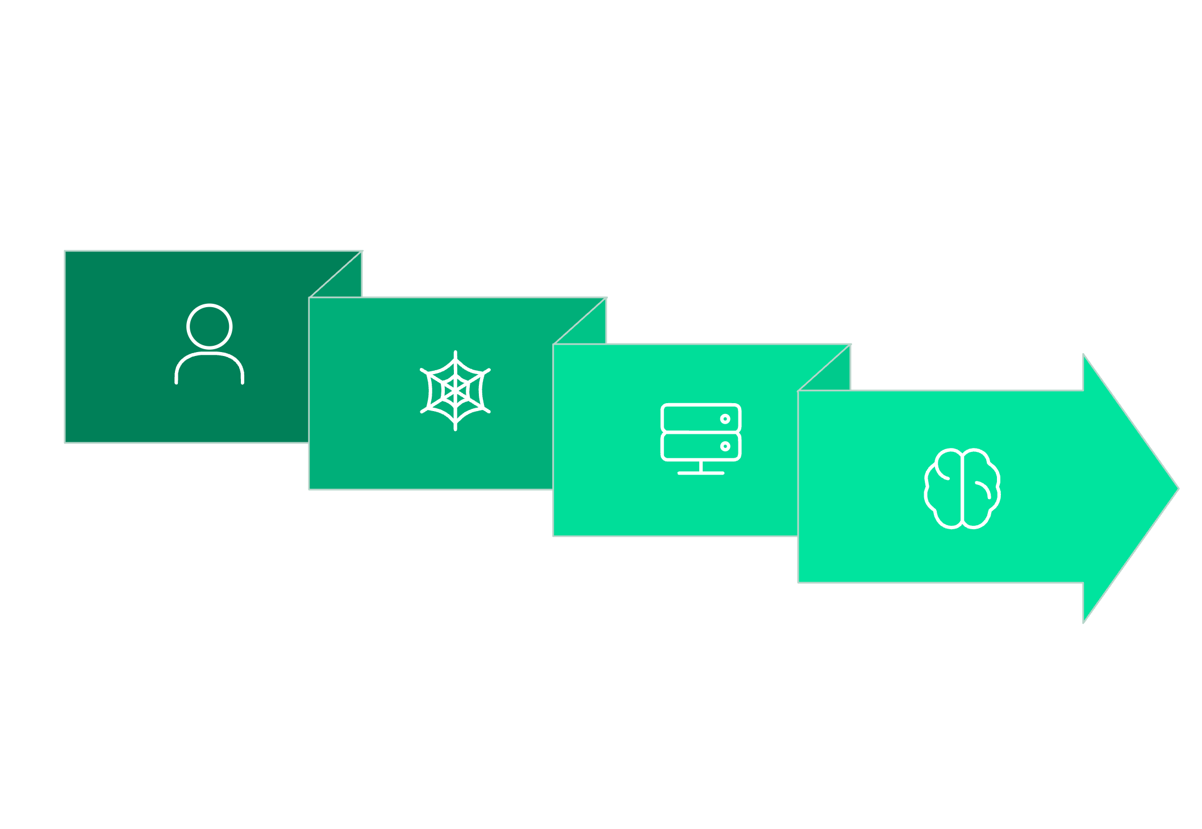
System Architecture — Data to Action
Web/PWA
AI Intelligence
Farmer
AgriBridge Backend
Pipeline: Data → Intelligence → Recommendation → Action → Monitoring. Backend: Flask/Python with CV and vernacular LLM components connected to weather APIs, SoilGrids, Sentinel-2 imagery and MQTT IoT feeds.
Tech Vision

Slide 5
Key Features — Visual Overview
Farm Intelligence
Satellite Monitoring
Field health, soil moisture, rainfall forecasts, disease risk scores.
True‑color and NDVI maps for early stress detection and yield estimation.
AI Disease Detection
Ask AgriAI
YOLOv8 models diagnose leaf diseases from farmer‑submitted images.
Vernacular conversational assistant — contextual, stepwise guidance.
Regenerative Farming
Rural Optimisation
Practice recommendations: rotation, intercropping, mulching, composting.
Low‑bandwidth, mobile‑first interface with multilingual support (EN/TE/HI).
Tech Vision

Slide 6
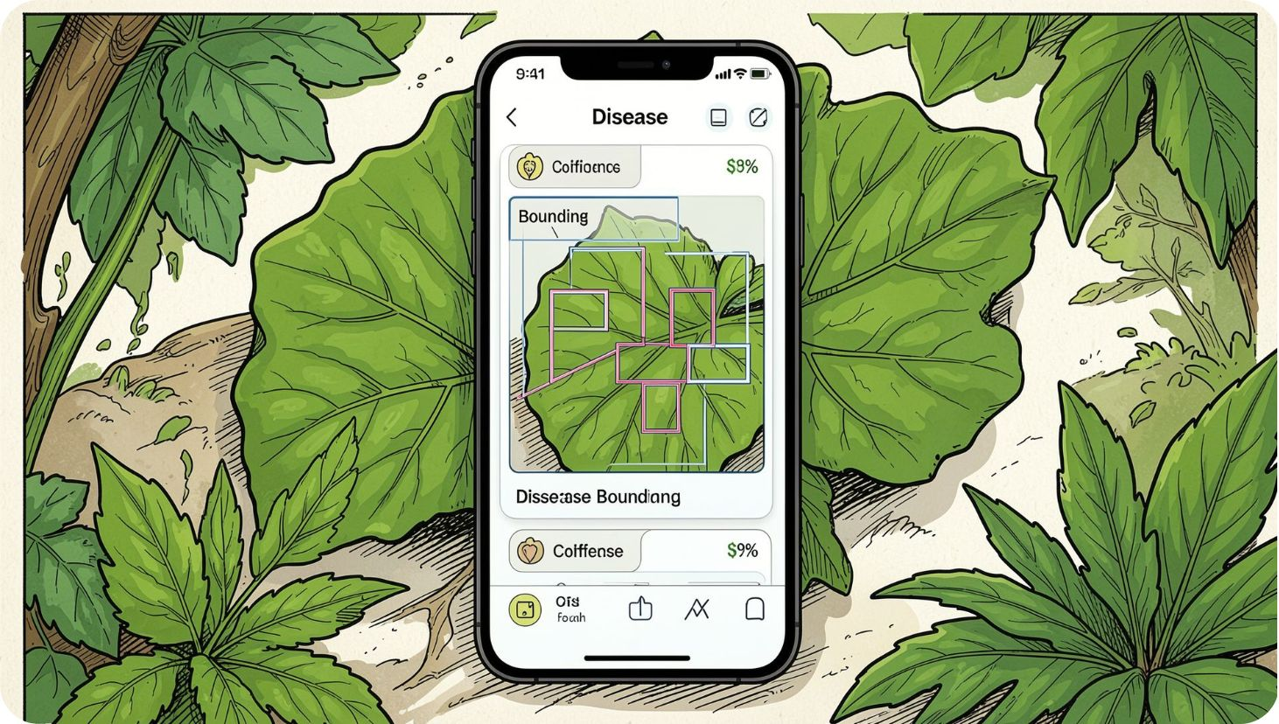
AI Disease Detection — Demo Flow
Detection Pipeline
Image capture by farmer → YOLOv8 inference (local/cloud)
Disease identification (example: Cercospora / Early Leaf Spot)
Confidence: 87% — Severity: Early Stage
Actionable output: biological & preventive interventions (rhizobium, mulching, spray timing)
Follow‑up: monitoring schedule and reminders sent via PWA
Prototype includes sample groundnut leaf inspection workflow and documented README steps.
Tech Vision

Slide 7
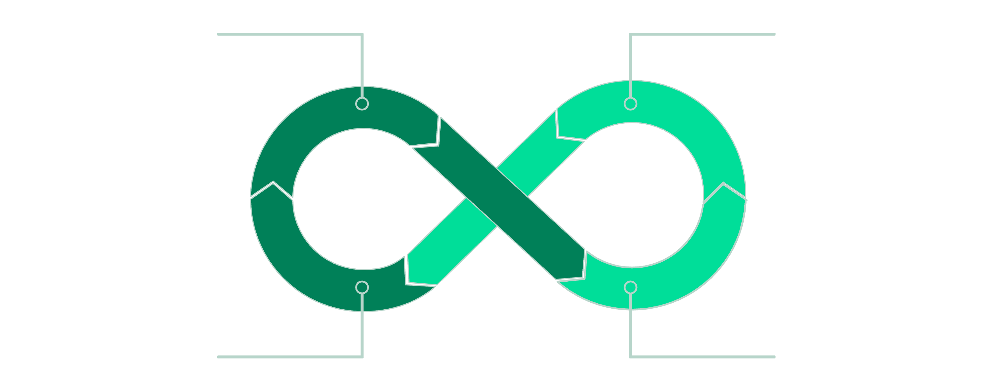
Regenerative Agriculture — Circular Practice Loop
Soil Health
Crop Diversity
Biological Management
Water Efficiency
Platform features: biomass mulching, groundnut+pigeon pea intercropping, crop rotation, vermicompost, Rhizobium inoculation, biological pest management. AgriBridge computes a regenerative score and translates it into a stepwise farm plan.
Tech Vision

Slide 8
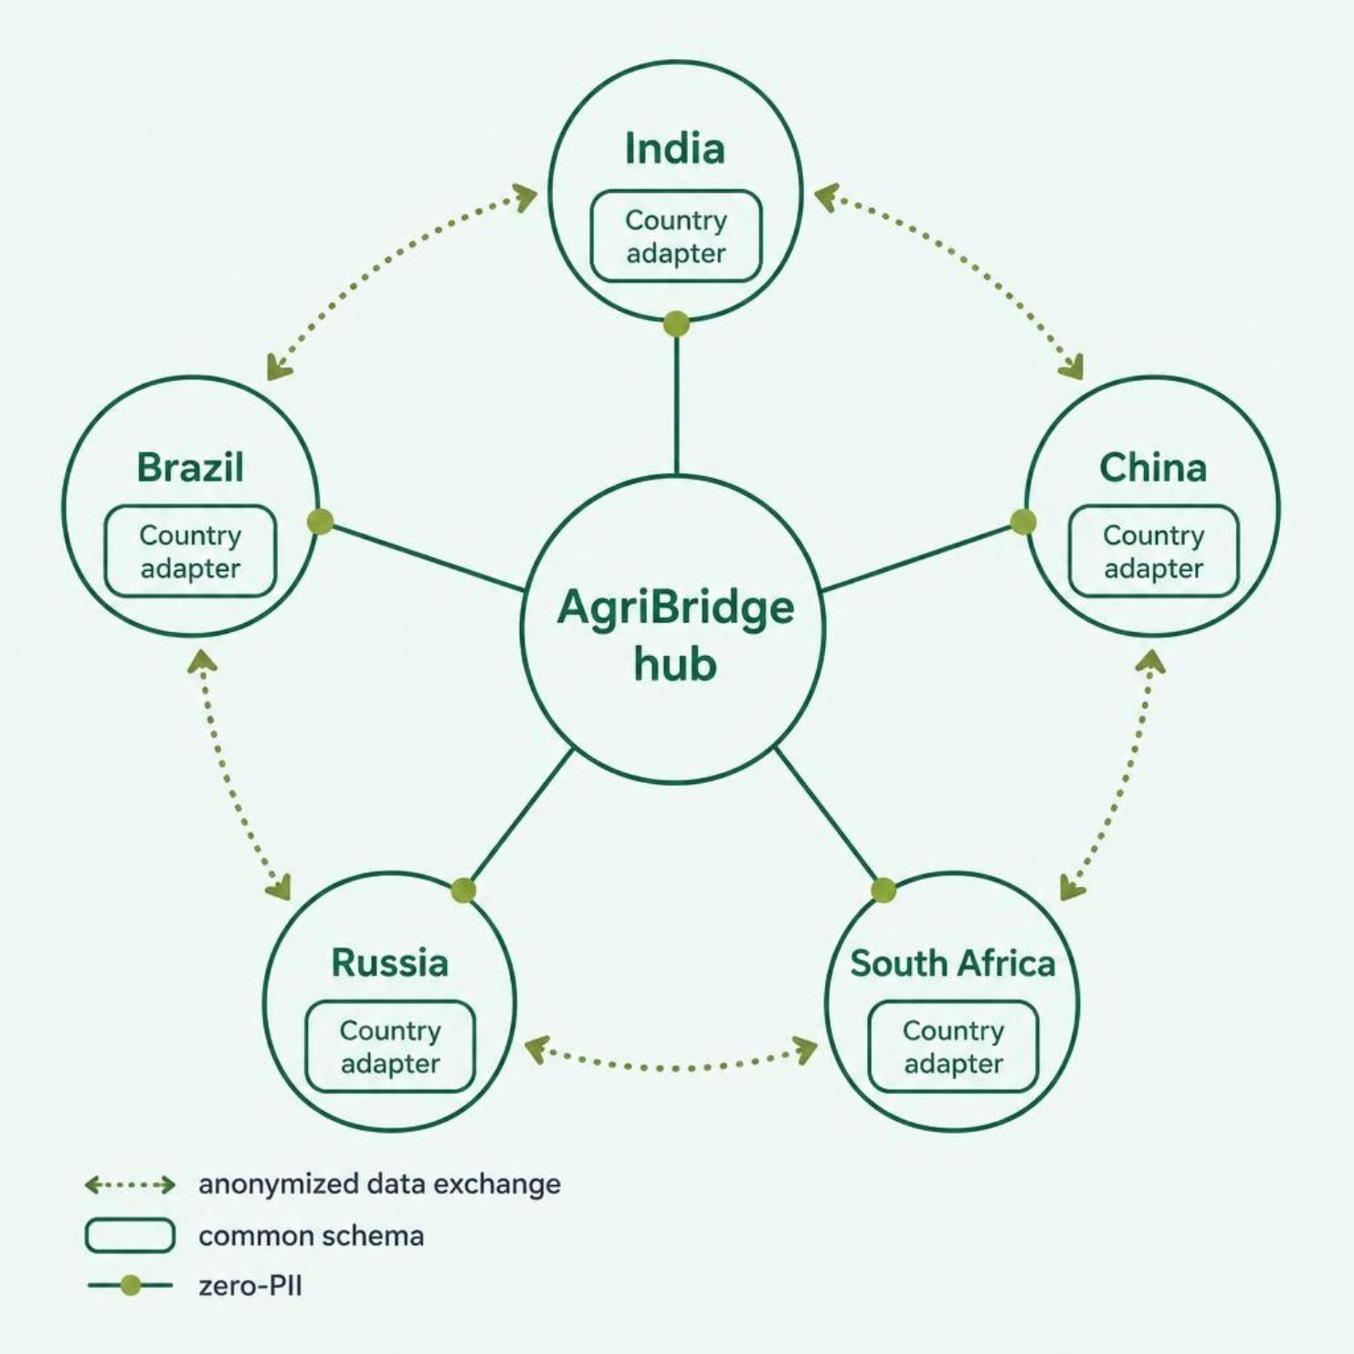
BRICS / AgriN Interoperability
AgriBridge supports cross‑border agricultural intelligence exchange across BRICS nations:
Standardised agricultural data model and country adapters
Anonymised, zero‑PII sharing for aggregated insights
Common schemas for crops, soil, weather and disease events
Localized transforms to respect regulatory and language differences
Tech Vision

Slide 9
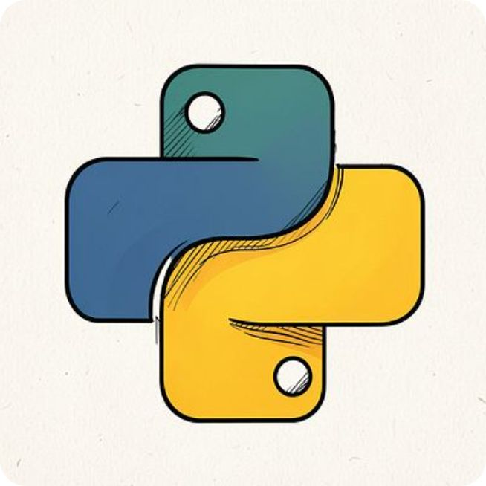
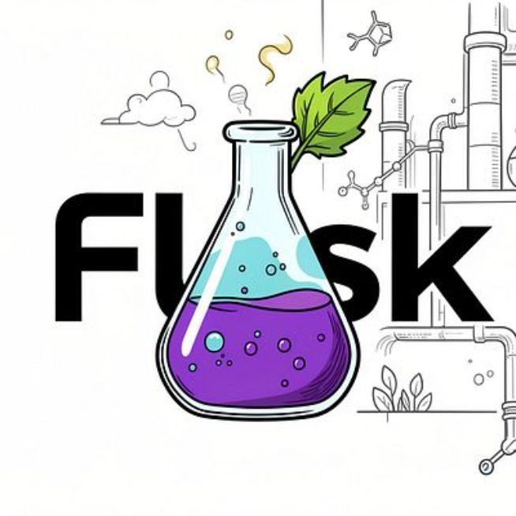


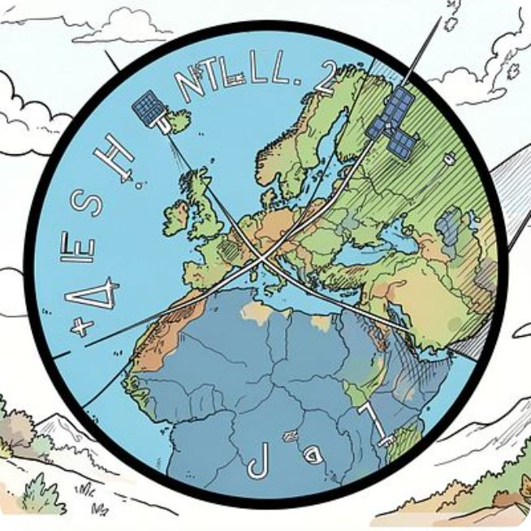
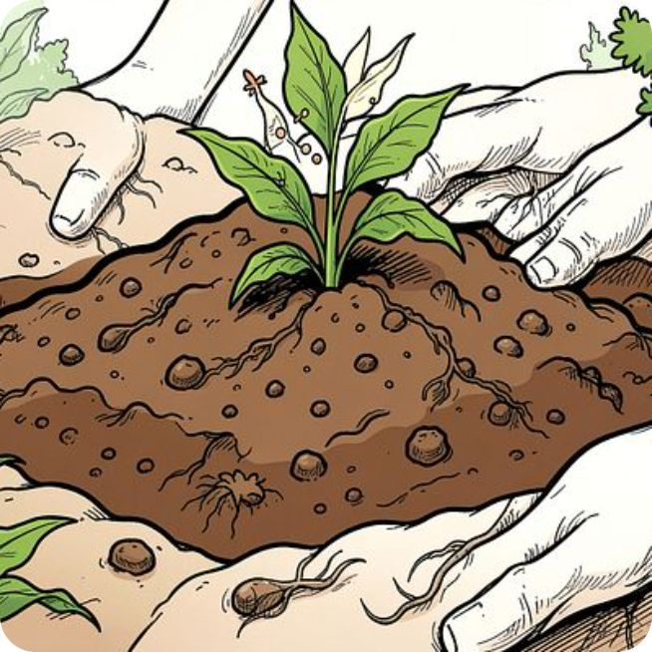
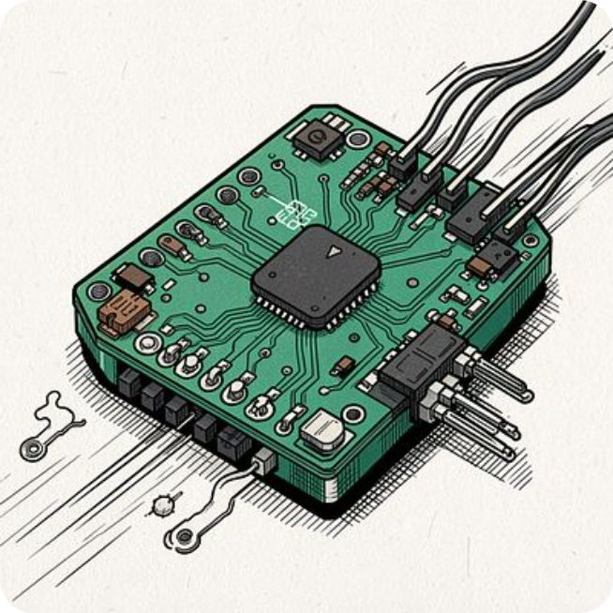
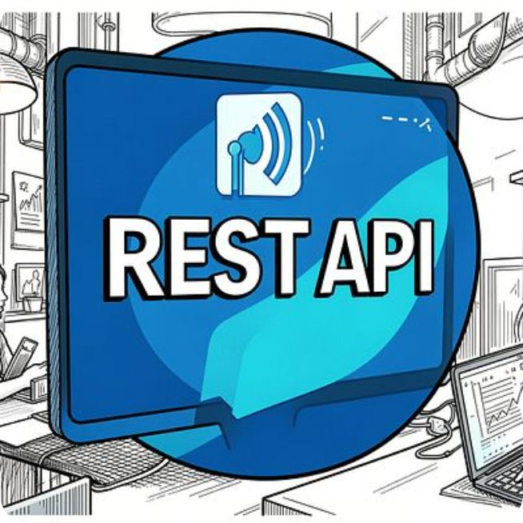
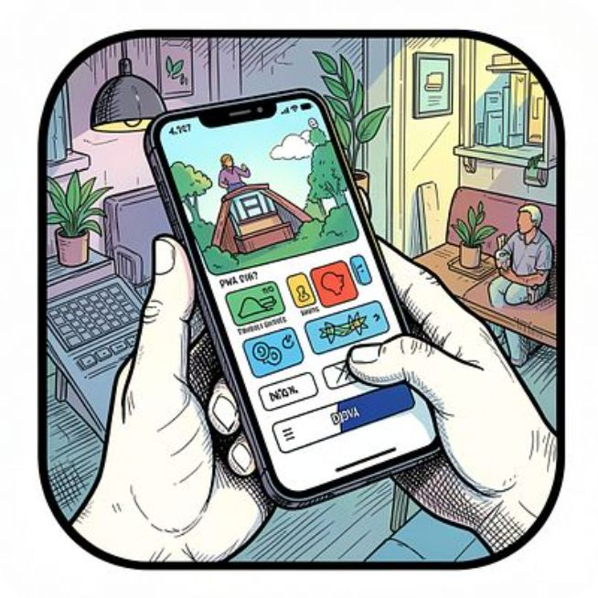
Technology Stack — What’s Implemented
Implemented components (repository‑verified): Frontend: responsive HTML/CSS/JS, PWA. Backend: Python + Flask. CV: YOLOv8 models. GenAI: Claude integration for advisory. Satellite: Sentinel‑2 NDVI processing. Soil: ISRIC SoilGrids. IoT: ESP32 + MQTT. APIs: REST/JSON. Languages: English, Telugu, Hindi.
Tech Vision

Slide 10
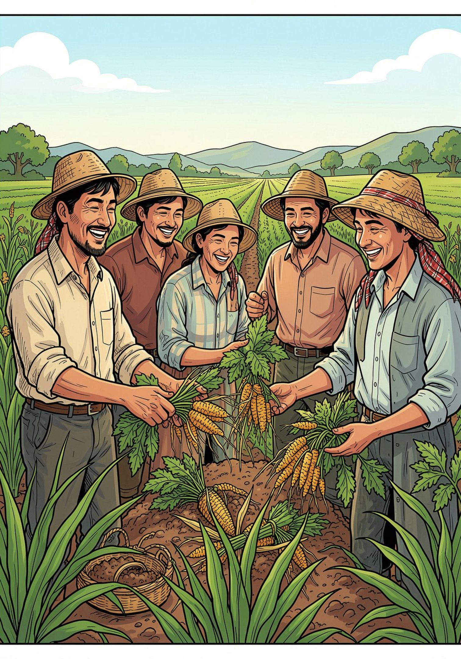
Impact & Roadmap
Expected Impact
Funding Needs
Faster, localised crop decisions and improved yields
Early disease detection reducing crop losses
Optimised water use and improved soil health
Scalable, interoperable data for climate resilience
Scale pilots, sensor deployment, model refinement, regional localisation
Partnerships
Research institutions, extension networks, BRICS data partners, funders
Roadmap
Now — Core AI advisory, disease detection, satellite intelligence, IoT baseline
Next — Voice-based regional AI, expanded IoT network, smart‑farm digital twins
Later — Crop traceability, enhanced BRICS interoperability and regional rollouts
Call to Action
Join us to scale AgriBridge — bring climate‑resilient intelligence to smallholders.
Tech Vision

Slide 11
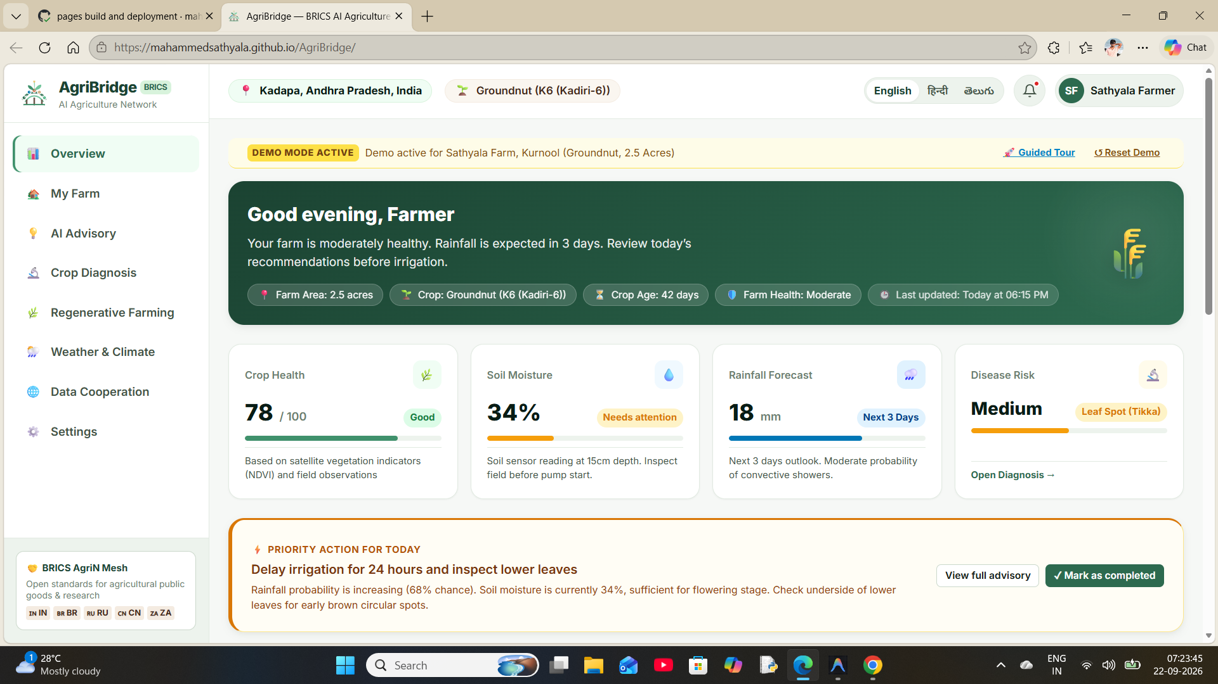
Interface
Links
GitHub: https://github.com/mahammedsathyala/AgriBridge
Demo Video: https://youtu.be/jV3ctbmCCyg
Prototype: AgriBridge — BRICS AI Agriculture Network
Tech Vision

